Slide 1
STORAGE AREA NETWORK
18CS822

Slide 2
SYLLABUS

Slide 3

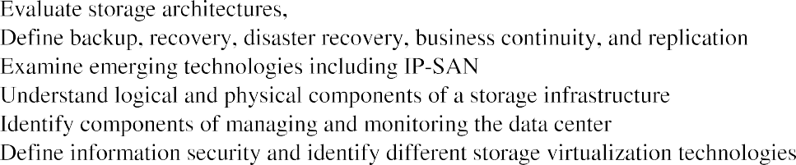
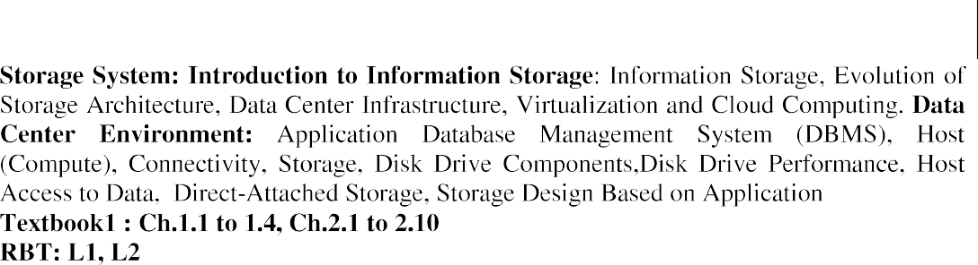
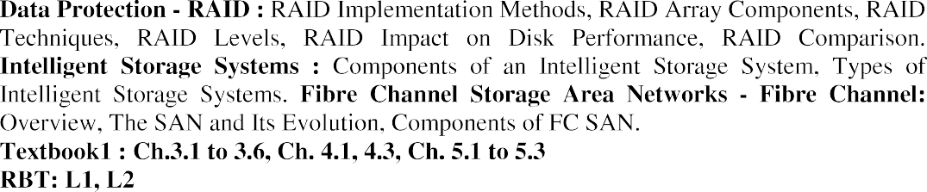
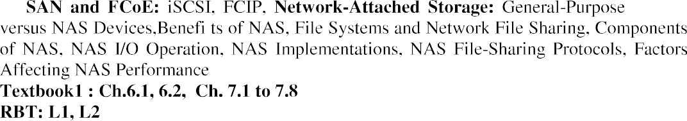
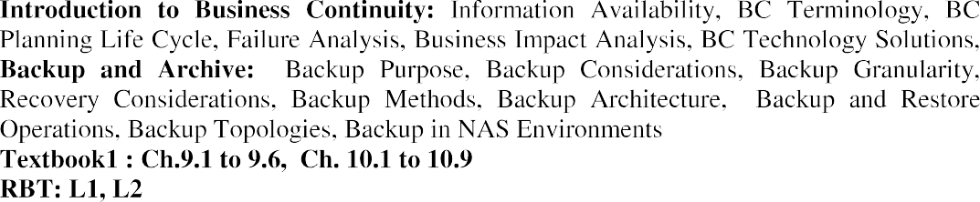

Slide 4
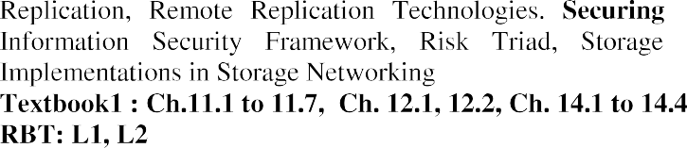
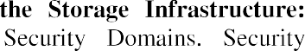
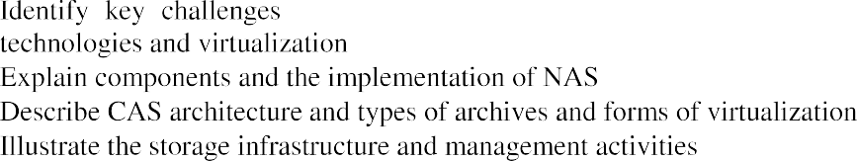
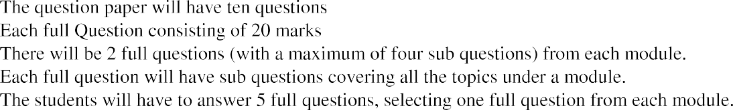

Slide 5
MODULE 1
CHAPTER 1: STORAGE SYSTEM

Slide 6
INFORMATION STORAGE

Slide 7
WHY INFORMATION STORAGE
21st century is called as information era.
Information is being created at every increasing rate.
We live in an on-command, on-demand world which means, we need information when and where it is required.
For ex: emails, search engines, online shopping etc. All of these are contributing to the digital universe.

Slide 8
WHY INFORMATION STORAGE
Information storage is a central pillar of information technology.
We access the internet every day to perform searches, participate in social networking, receive emails, share pictures/video etc.
We are equipped with a increasing number of content generating devices, which creates more information by individuals than by businesses.
A large amount of digital information is created every moment by individuals and organizations.
Information created by individuals gains value when shared with others.

Slide 9
WHY INFORMATION STORAGE
This information needs to be stored, protected, optimized and managed in classic, virtualized and rapidly evolving cloud environments.
Organizations maintain one or more data centers to store and manage information.
When created, information resides locally on devices, such as cell phones, smartphones, tablets, cameras, laptops.
To be shared, this information needs to be uploaded to central data repositories (data centers) via networks.
Although, the majority of the information is created by individuals, it is stored and managed by a relatively small number of organizations

Slide 10
INFORMATION STORAGE
Businesses depend on fast and reliable access to information critical to their success.
Example of business processes or systems that rely on digital information include airline reservations, telecommunications billing, electronic banking, credit card transaction processing, shares/stocks trading, life science research etc.
The increasing dependence of businesses on information has amplified the challenges in : storing data protecting data managing data

Slide 11
INFORMATION STORAGE
Information management is a big challenge.
Information management involves: Storing the information Protecting the information Optimizing the information Leveraging the information

Slide 12
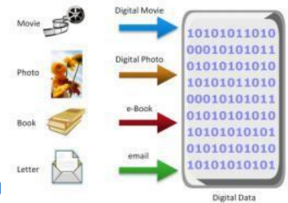
DATA
Data: Collection of raw facts from which conclusions may be drawn.
Data will be converted from its physical form to more convenient form i.e., to Digital form.
Data is convenient to handle in Digital form because: Increases in data processing capabilities Lower cost of digital storage Affordable and faster communication technology

Slide 13
FACTORS FOR GROWTH OF DATA
Factors that have contributed to the growth of digital data:
1. Increase in data processing capabilities: Modern computers provide a significant increase in processing and storage capabilities This enables the conversion of various types of content and media from conventional forms to digital formats.
2. Lower cost of digital storage: Technological advances and the decrease in the cost of storage devices have provided low-cost storage solutions This cost benefit has increased the rate at which digital data is generated and stored

Slide 14
FACTORS FOR GROWTH OF DATA
3. Affordable and faster communication technology:
The rate of sharing digital data is now much faster than traditional approaches.
A hand written letter might take a week to reach its destination, whereas it typically takes only few seconds for an e-mail message to reach its recipient.
4. Proliferation of applications and smart devices:
Smartphones, tablets and newer digital devices, along with smart applications, have significantly contributed to the generation of digital content.

Slide 15
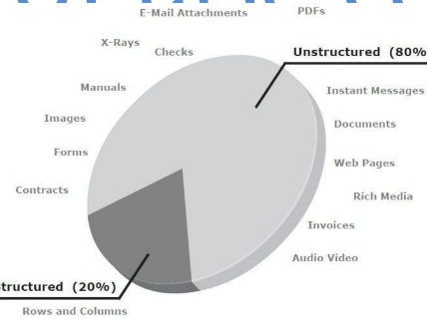
TYPES OF DATA
Data can be classified as either Structured Data Unstructured Data
Structured data: Structured data is organized in rows and columns in a rigidly defined format so that applications can retrieve and process it efficiently. Structured data is typically stored using a database management system (DBMS)
Unstructured data: Data is unstructured if its elements cannot be stored in rows and columns & is therefore difficult to query and retrieve by business applications Example: e-mal messages, digital format files like .doc, .txt, .pdf Over 80% of enterprise information is unstructured

Slide 16
BIG DATA
It refers to the datasets whose sizes are beyond the capability of commonly used software tools to capture, store, manage and process within acceptable time limits.
These data sets typically require real time capture or updates for analysis, predictive modeling and decision making.
Big data ecosystem consists of the following: 1.Devices that collect data from multiple locations and also generate new data about this data (metadata).
2. Data collectors who gather data from devices and users. 3. Data aggregators that compile the collected data to extract meaningful information. 4. Data users and buyers who benefit from the information collected and aggregated by others in the data value chain .

Slide 17
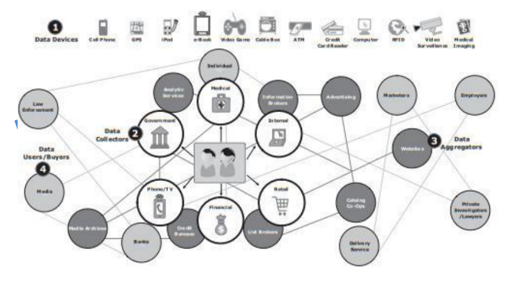
BIG DATA
Big data ecosystem:

Slide 18
INFORMATION
Data, whether structured or unstructured, does not fulfil any purpose for individuals or businesses unless it is presented in a meaningful form.
Information is the intelligence and knowledge derived from data.
Businesses analyze raw data in order to identify meaningful trends.
On the basis of these trends, a company can plan or modify its strategy.
For example, a retailer identifies customers’ preferred products and brand names by
analyzing their purchase patterns and maintaining an inventory of those products.
Because information is critical to the success of a business, there is an ever present
concern about its availability and protection.

Slide 19
STORAGE
Data created by individuals/ businesses must be stored for further processing.
Type of storage used is based on the type of data and the rate at which it is created and used.
Examples: Individuals: Digital camera, cell phone, Hard disk Businesses: Hard disk, external disk arrays, tape library

Slide 20
EVOLUTION OF STORAGE ARCHITECTURE

Slide 21
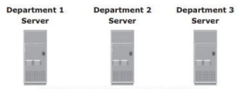
INTRODUCITON TO EVOLUTION OF STORAGE ARCHITECTURE
Historically, organizations had centralized computers (mainframe) and information storage devices (tape reels and disk packs) in their data center.
The evolution of open systems and the affordability and ease of deployment that they offer made it possible for business units/departments to have their own servers and storage.
In earlier implementations of open systems, the storage was typically internal to the server.
These storage devices could not be shared with any other servers.
This approach is referred to as Server-Centric Storage Architecture

Slide 22
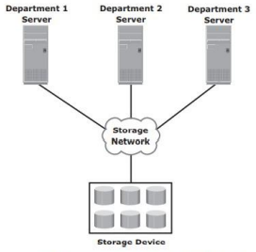
INTRODUCITON TO EVOLUTION OF STORAGE ARCHITECTURE
In server centric storage architecture, each server has a limited number of storage devices. If any administrative tasks like maintenance of server/ increasing storage capacity might result in unavailability of information.
To overcome these challenges, storage evolved from Server centric to Information-Centric Architecture.

Slide 23
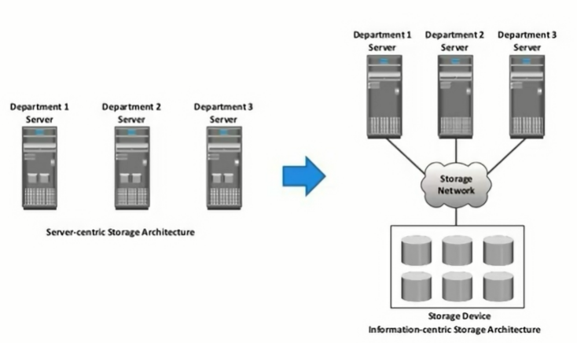
INTRODUCITON TO EVOLUTION OF STORAGE ARCHITECTURE

Slide 24
EVOLUTION OF STORAGE ARCHITECTURE
In Information-centric architecture, storage devices are managed centrally and are independent of servers.
These centrally managed storage devices are shared with multiple servers.
When a new server is deployed in the environment, storage is assigned from the same shared storage devices to that server.
The capacity of shared storage can be increased dynamically by adding more storage devices without impacting information availability.
In this architecture, information management is easier and cost effective.

Slide 25
DATA CENTER INFRASTRUCTURE

Slide 26
CORE ELEMENTS OF A DATA CENTER
Application: An application is a computer program that provides the logic for computing operations. Eg: order processing system.
Database: More commonly, a database management system (DBMS) provides a structured way to store data in logically organized tables that are interrelated. A DBMS optimizes the storage and retrieval of data. Helps to fetch data as and when it is required.
Host or compute: A computing platform (hardware, firmware, and software) that runs applications and databases.
Network: A data path that facilitates communication among various networked devices.
Storage array: A device that stores data persistently for subsequent use.

Slide 27
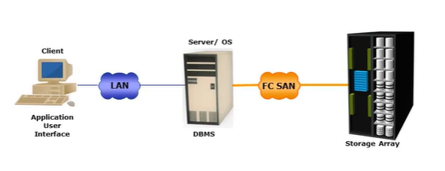
CORE ELEMENTS OF A DATA CENTER
Example of an Order Processing System:

Slide 28
KEY REQUIREMENTS FOR DATA CENTER ELEMENTS
Availability: All data center elements should be designed to ensure accessibility. The inability of users to access data can have a significant negative impact on a business.
Security: Polices, procedures, and proper integration of the data center core elements that will prevent unauthorized access to information must be established. Specific mechanisms must enable servers to access only their allocated resources on storage arrays.
Scalability: Data center operations should be able to allocate additional processing capabilities (eg: servers, new applications, and additional databases) or storage on demand, without interrupting business operations. The storage solution should be able to grow with the business.

Slide 29
KEY REQUIREMENTS FOR DATA CENTER ELEMENTS
Performance: All the core elements of the data center should be able to provide optimal performance and service all processing requests at high speed. The infrastructure should be able to support performance requirements.
Data integrity: Data integrity refers to mechanisms such as error correction codes or parity bits which ensure that data is written to disk exactly as it was received. Any variation in data during its retrieval implies corruption, which may affect the operations of the organization.
Capacity: Data center operations require adequate resources to store and process large amounts of data efficiently. When capacity requirements increase, the data center must be able to provide additional capacity without interrupting availability, or, at the very least, with minimal disruption. Capacity may be managed by reallocation of existing resources, rather than by adding new resources.
Manageability: A data center should perform all operations and activities in the most efficient manner. Manageability can be achieved through automation and the reduction of human (manual) intervention in common tasks.

Slide 30
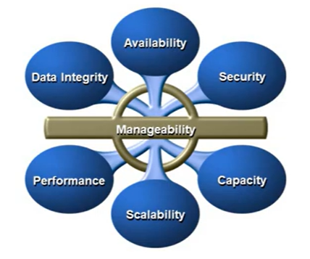
KEY REQUIREMENTS FOR DATA CENTER ELEMENTS

Slide 31
MANAGING STORAGE INFRASTRUCTURE
Managing a modern, complex data center involves many tasks.
Key management activities include:
Monitoring: Continuous collection of information and the review of the entire data center infrastructure. The aspects of a data center that are monitored include security, performance, accessibility and capacity.
Reporting: It is done periodically on resource performance, capacity and utilization.
Provisioning: It is the process of providing the hardware, software and other resources needed to run a data center. Provisioning activities include capacity planning (ensures that the user’s and the application’s future needs will be addressed in the most cost-effective and controlled manner) and resource planning (ensures adequate resources are available to meet user and application requirements).

Slide 32
CHALLENGES IN MANAGING INFORMATION
Exploding digital universe:
Multifold increase of information growth
Increasing dependency on information:
The strategic use of information plays an important role
Changing value of information:
Information that is valuable today may become less important tomorrow.

Slide 33
VIRTUALIZATION AND CLOUD COMPUTING

Slide 34
VIRTUALIZATION
Virtualization is a technique of abstracting physical resources, such as compute, storage and network, and making them appear as logical resources.
Virtualization enables pooling of resources and providing an aggregation view of the physical resource capabilities.
It also enables centralized management of pooled resources.
Virtual resources can be created and provisioned from the pooled physical resources
Based on business requirements, capacity can be added to or removed from the virtual resources without any disruption to application or users.

Slide 35
CLOUD COMPUTING
Cloud computing enables individuals or businesses to use IT resources as a service over the network.
It provides highly scalable and flexible computing that enables provisioning of resources on demand.
Users can scale up or scale down the demand of computing resources, including storage capacity, with minimal management effort or service provider interaction.
It empowers self-service requesting through a fully automated request-fulfillment process
It enables consumption-based metering
Cloud infrastructure is usually built upon virtualized data centers.

Slide 36
MODULE 1
CHAPTER 2: DATA CENTER ENVIRONMENT

Slide 37
APPLICATION DATABASE MANAGEMENT SYSTEM

Slide 38
APPLICATION
An application is a computer program that provides the logic for computing operations.
The applications sends requests to the underlying operating system to perform read/write (R/W) operations on the storage devices.
Applications can be layered on the database, which in turn uses the OS services to perform R/W operations on the storage devices.
Applications deployed in a data center environment are commonly categorized as business applications : email, enterprise resource planning infrastructure management applications : Resource management, virtualization data protection applications: backup security applications: authentication, antivirus

Slide 39
APPLICATION
Some examples of these applications are e-mail, enterprise resource planning (ERP), decision support system (DSS), resource management, backup, authentication and antivirus application and so on.
The characteristics of I/Os generated by the application influence the overall performance of storage system and storage solution designs.

Slide 40
APPLICATION VIRTUALIZATION
Application virtualization breaks the dependency between the application and the underlying platform (OS and hardware).
Application virtualization encapsulates the application and the required OS resources within a virtualized container.
This technology provides the ability to deploy applications without making any change to the underlying OS, file system, or registry of the computing platform on which they are deployed.
Because virtualized applications run in an isolated environment, the underlying OS and other applications are protected from potential corruptions.
Application virtualization eliminates this conflict among multiple applications by isolating different versions of an application and the associated O/S resources.

Slide 41
DATABASE MANAGEMENT SYSTEM
A database is a structured way to store data in logically organized tabled that are interrelated.
A database helps to optimize the storage and retrieval of data.
A DBMS controls the creation, maintenance and use of a database.
The DBMS processes an application’s request for data and instructs the operating system to transfer the appropriate data from the storage.

Slide 42
HOST

Slide 43
HOST
Users store and retrieve data through applications.
The computers on which these applications run are referred to as hosts or compute systems.
Hosts can be physical or virtual machines.
A compute virtualization software enables creating virtual machines on top of a physical compute infrastructure.
Examples of physical hosts include desktop computers, servers or a cluster of servers, laptops and mobile devices.

Slide 44
HOST
A host consists of CPU, memory, I/O devices and a collection of software to perform computing operations.
This software includes the operating system, file systems, logical volume manager, device drivers and so on.
This software can be installed as separate entities or as part of the operating system.
The CPU consists of four components: Arithmetic Logic Unit (ALU), control unit, registers and L1 cache.
There are two types of memory on a host, Random Access Memory (RAM) and Read-Only Memory (ROM).
I/O devices enable communication with a host. Examples of I/O devices are keyboard, mouse, monitor etc.
Software runs on a host and enables processing of input and output (I/O) data.

Slide 45
MEMORY VIRTUALIZATION
Memory has been and continues to be an expensive component of a host.
It determines both the size and the number of applications that can run on a host.
Memory virtualization enables multiple applications and processes, whose aggregate memory requirement is greater than the available physical memory, to run on a host without impacting each other.
Memory virtualization is an operating system feature that virtualizes the physical memory (RAM) of a host.
The space used by the VMM on the disk is known as a swap space.
A swap space is a portion of the disk drive that appears to be physical memory to the operating system.
In a virtual memory implementation, the memory of a system is divided into contiguous blocks of fixed-size pages.

Slide 46
MEMORY VIRTUALIZATION
A process known as paging moves inactive physical memory pages onto the swap file and brings them back to the physical memory when required.
This enables efficient use of the available physical memory among different applications.
The operating system typically moves the least used pages into the swap file so that enough RAM is available for processes that are more active.
Access to swap file pages is slower than access to physical memory pages because swap file pages are allocated on the disk drive, which is slower than physical memory.

Slide 47
DEVICE DRIVER
A device driver is special software that permits the operating system to interact with a specific device, such as a printer, a mouse or a disk drive.
A device driver enables the operating system to recognize the device and to access and control devices.
Device drivers are hardware-dependent and operating system specific.

Slide 48
VOLUME MANAGER
In the early days, disk drives appeared to the operating system as a number of continuous disk blocks.
The entire disk drive would be allocated to the file system or other data entity used by the operating system or applications.
The disadvantage was lack of flexibility. When a disk drive ran out of space, there was no easy way to extend the file system’s size.
Also, as the storage capacity of the disk drive increased, allocating the entire disk drive for the file system often resulted in under utilization of storage capacity,

Slide 49
VOLUME MANAGER
The evolution of Logical Volume Managers (LVMs) enabled dynamic extension of file system capacity and efficient storage management.
The LVM is software that runs to the compute system and manages logical and physical storage.
LVM is an intermediate layer between the file system and the physical disk.
It can partition a larger capacity disk into virtual, smaller- capacity volumes(the process si called partitioning) or aggregate several smaller disks to form a larger virtual volume (The process is called concatenation).
These volumes are the presented to applications.

Slide 50
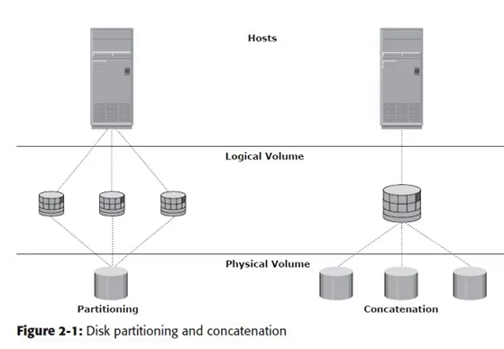
VOLUME MANAGER

Slide 51
VOLUME MANAGER
The LVM provides optimized storage access and simplifies storage resource management.
It hides details about the physical disk and the location of data on the disk.
It enables administrators to change the storage allocation even when the application is running.
Physical volumes can be added or removed from a volume group dynamically.
The physical volumes cannot be shared between different volume groups, which means that the entire physical volume becomes part of a volume group.
Each physical volume is partitioned into equal-sized data blocks called physical extents when the volume group is created.

Slide 52
FILE SYSTEM
A file is a collection of related records or data stored as a unit with a name.
A file system is a hierarchical structures of files.
A file system enables easy access to data files residing within a disk drive, a disk partition or a logical volume.
A file system consists of logical structures and software routines that control access to files.
It provides users with the functionality to create, modify, delete and access files.
Access to files on the disks is controlled by the permissions assigned to the file by the owner, which are also maintained by the file system.

Slide 53
FILE SYSTEM
A file system organized data in a structured hierarchical manner via the use of directors, which are container for storing pointers to multiple files.
All file systems maintain a pointer map to the directories, subdirectories and files that are part of the file system.
Apart from the files and directories, the file system also includes a number of other related records, which are collectively called the metadata.
For example, the metadata in a UNIX environment consists of the superblock, the inode and the list of data blocks free and in use.
The metadata of a file system must be consistent for the file system to be considered healthy.
A superblock contains important information about the file system, such as the file system type, creation and modification dates, size and layout

Slide 54
FILE SYSTEM
It also contains the count of available resources and a flag indicating the mount status of the file system.
An inode is associated with every file and directory and contains information such as the file length, ownership, access privileges, time of last access/modification, number of links, and the address of the data.
A file system block is the smallest “unit” allocated for storing data.
Each file system block is a contiguous area on the physical disk. The block size of a file system is fixed at the time of its creation.
The file system size depends on the block size and the total number of file system blocks.
A file can span multiple file system blocks because most files are larger than the predefined block size of the file system.

Slide 55
FILE SYSTEM
File system blocks cease to be contiguous and become fragmented when new blocks are added or deleted.
Over time, as files grown larger, the file system becomes increasingly fragmented.
The file system tree starts with the root directory. The root directory has a number of subdirectories. A file system should be mounted before it can be used.

Slide 56
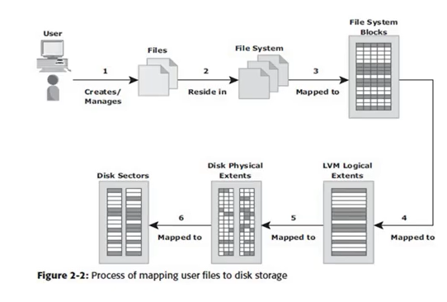
FILE SYSTEM

Slide 57
FILE SYSTEM – JOURNALING Vs NONJOURNLAING
Nonjournaling file system cause a potential loss of files because they use separate writes to update their data and metadata.
If the system crashes during the write process, the metadata or data might be lost or corrupted.
When the system reboots, the file system attempts to update the metadata structures by examining and repairing them.
This operation takes a long time on large file systems.
If there is insufficient information to recreate the wanted or original structure, the files might be misplaced or lost, resulting in corrupted file systems.

Slide 58
FILE SYSTEM – JOURNALING Vs NONJOURNLAING
Journaling file system uses a separate area called a log or journal.
This journal might contain all the data to be written or just the metadata to be updated.
Before changes are made to the file system, they are written to this separate area.
After the journal has been updated, the operation on the file system can be performed.
If the system crashes during the operation, there is enough information in the log to “replay” the log record and complete the operation.

Slide 59
FILE SYSTEM – JOURNALING Vs NONJOURNLAING
Journaling results in a quick file system check because it looks only at the active, most recently accessed parts of a large file system.
In addition, because information about the pending operation is saved, the risk of files being lost is reduced.
A disadvantage of journaling file systems is that they are slower than other file systems.
This slowdown is the result of the extra operations that have to be performed on the journal each time the file system is changed.
However, the much shortened time for the file system checks and the file system integrity provided by journaling far outweighs its disadvantage.
Nearly all the file system implementations today use journaling.

Slide 60
COMPUTE VIRTUALIZATION
Compute virtualization is a technique for masking or abstracting the physical hardware from the operating system.
It enables multiple operating systems to run concurrently on single or clustered physical machines.
This technique enables creating portable virtual compute systems called virtual machines (VMs).
Each VM runs its own operating system and application instance in an isolated manner.

Slide 61
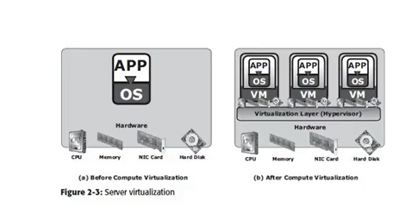
COMPUTE VIRTUALIZATION

Slide 62
COMPUTE VIRTUALIZATION
A virtual machine is a logical entity but appears like a physical host to the operating system, with its own CPU, memory, network controller, and disks.
However, all VMs share the same underlying physical hardware in an isolated manner.
From a hypervisor perspective, virtual machines are discrete sets of files that include VM configuration file, data files and so on.
Typically, a physical server often faces resource-conflict issues when two or more applications running on the server have conflicting requirements.
Server consolidation enables organizations to run their data center with fewer physical servers.

Slide 63
COMPUTE VIRTUALIZATION
This, in turn,
reduces cost of new server acquisition,
reduces operational cost,
saves data centre floor and rack space.
Creation of VMs takes less time compared to a physical server setup; organizations can provision servers faster and with ease.
Individual VMs can be restarted, upgraded, or even crashed, without affecting the other VMs.
Moreover, VMs can be copied or moved from one physical machine to another without causing application downtime.
Nondisruptive migration of VMs is required for load balancing among physical machines, hardware maintenance and availability purposes.

Slide 64
CONNECTIVITY

Slide 65
CONNECTIVITY
Connectivity refers to the interconnection between hosts or between a host and peripheral devices, such as printers or storage devices.
In this chapter we focus only on the connectivity between the host and the storage device.
Connectivity and communication between host and storage are enabled using physical components and interface protocols.

Slide 66
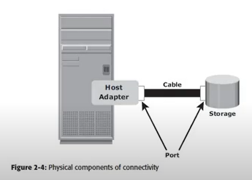
CONNECTIVITY

Slide 67
CONNECTIVITY
A host interface device or host adapter connects a host to other hosts and storage devices.
Examples of host interface devices are host bus adapter (HBA) and network interface card (NIC).
Host bus adapter is an application specific integrated circuit (ASIC) board that performs I/O interface functions between the host and storage, relieving the CPU from additional I/O processing workload.
A host typically contains multiple HBAs.
A port is a specialized outlet that enables connectivity between the host and external devices.
An HBA may contain one or more ports to connect the host.

Slide 68
INTERFACE PROTOCOLS: IDE/ATA & SERIAL ATA
IDE/ATA is a popular interface protocol standard used for connecting storage devices, such as disk drives and CD-ROM drives.
This protocol supports parallel transmission and therefore is also known as Parallel Ata (PATA) or simply ATA.
IDE/ATA has a variety of standard and names.
The ultra DMA/133 version ATA supports a throughput of 133 MB per second. In a master-slave configuration, an ATA interface supports two storage devices per connector.
However, if the performance of the drive is important, sharing a port between two devices is not recommended.
The serial version of this protocol supports single bit serial transmission and is known as Serial ATA (SATA).

Slide 69
INTERFACE PROTOCOLS: IDE/ATA & SERIAL ATA
High performance and low cost SATA has largely replaced PATA in newer systems.
SATA revision 3.0 provides a data transfer rate up to 6 Gb/s

Slide 70
INTERFACE PROTOCOLS: SCSI & SERIAL SCSI
SCSI has emerged as a preferred connectivity protocol in high end computers.
This protocol supports parallel transmission and offers improved performance, scalability and compatibility compared to ATA.
However, the high cost associated with SCSI limits its popularity among home or personal desktop users.
Over the years, SCSI has been enhanced and now includes a wide variety of related technologies and standards.
SCSI supports up to 16 devices on a single bus and provides data transfer rates up to 640 MB/s
Serial attached SCSI is a point-to-point serial protocol that provides an alternative to parallel SCSI.
N newer version of serial SCSI supports a data transfer rate up to 6Gb/s.

Slide 71
INTERFACE PROTOCOLS: IP
IP is a network protocol that has been traditionally used for host-to-host traffic.
With the emergence of new technologies, an IP network has become a viable option for host-to-storage communication.
IP offers several advantages in terms of cost and maturity and enabled organizations to leverage their existing IP based network.
ISCSI and FCIP protocols are common examples that leverage IP for host-to-storage communication.

Slide 72
STORAGE

Slide 73
STORAGE
The storage device is the most important component in the storage system environment.
A storage devices uses magnetic or solid state media.
Disks, tapes and diskettes use magnetic media.
CD/DVD is an example of a storage device that uses optical media, and removable flash memory card is an example of solid state media.
Tapes are a popular storage media used for backup because of their relatively low cost.

Slide 74
TAPE LIMITATIONS
Data is stored on the tape linearly along the length of the tape.
Search and retrieval of data is done sequentially, invariably taking several seconds to access the data.
As a result, random data access is slow and time consuming.
This limits tapes as a viable option for applications that require real-time, rapid access to data.
In a shared computing environment, data stored on tape cannot be accessed by multiple applications simultaneously, restricting its use to one application at a time.
On a tape drive, the read/write head touches the tape surface, so the tape degrades or wears out after repeated use.
The storage and retrieval requirements of data from tape and the overhead associated with managing tape media are significant.

Slide 75
OPTICAL DISC STORAGE
Due to these limitations and availability of low-cost disk drives, tapes are no longer preferred choice as a backup destination for enterprise class data centers.
Optical disc storage is popular in small, single-user computing environments.
It is frequently used by individuals to store photos or as a backup medium on personal or laptop computers.
It is also used as distribution medium for small applications, such as games, or as a means to transfer small amounts of data from one computer to another.
Optical discs have limited capacity and speed, which limit the use of optical media as a business data storage solution.

Slide 76
OPTICAL DISC STORAGE
The capability to write once and read many (WORM) is one advantage of optical disc storage.
A CD-ROM is an example of a WORM device.
Optical discs, to some degree, guarantee that the content has not been altered.
Therefore it can be used as a low-cost alternative for long-term storage of relatively small amounts of fixed content that do not change after it is created.

Slide 77
DISK DRIVE COMPONENT

Slide 78
DISK DRIVE COMPONENTS
The key components of a hard disk drive are: platter spindle read-write head actuator arm assembly controller board

Slide 79
DISK DRIVE COMPONENTS
I/O operations in a HDD are performed by rapidly moving the arm across the rotating flat platters coated with magnetic particles.
Data is transferred between the disk controller and magnetic platters through the read-write (R/W) head which is attached to the arm.
Data can be recorded and erased on magnetic platters any number of times

Slide 80
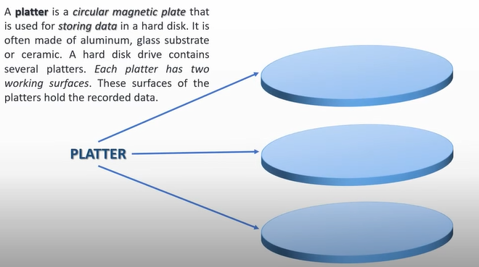
DISK DRIVE COMPONENTS - PLATTER

Slide 81
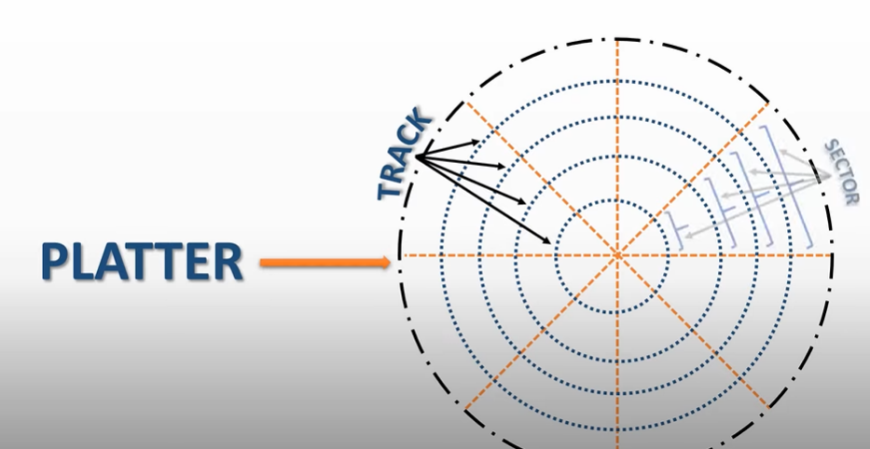
DISK DRIVE COMPONENTS - PLATTER

Slide 82
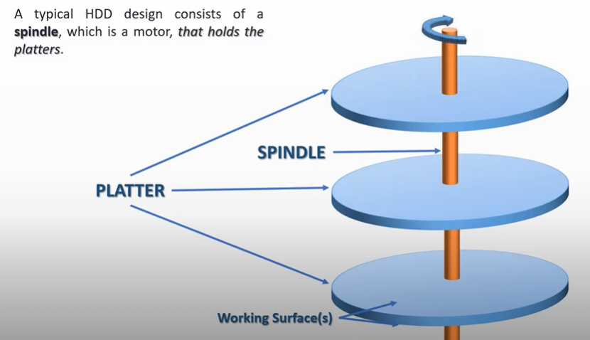
DISK DRIVE COMPONENTS - SPINDLE

Slide 83
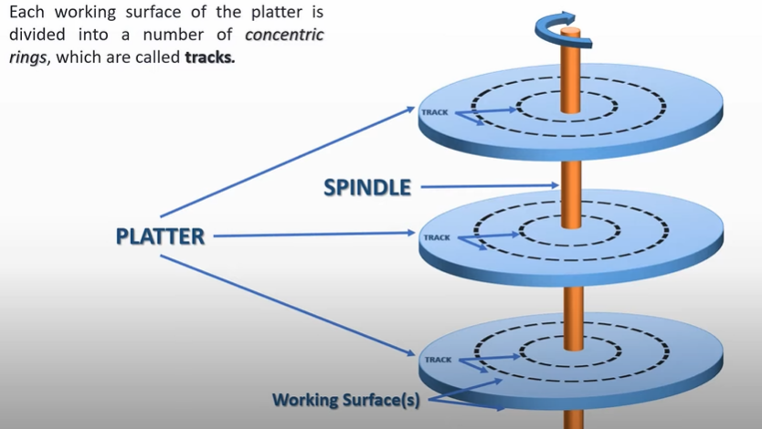
DISK DRIVE COMPONENTS - TRACKS

Slide 84
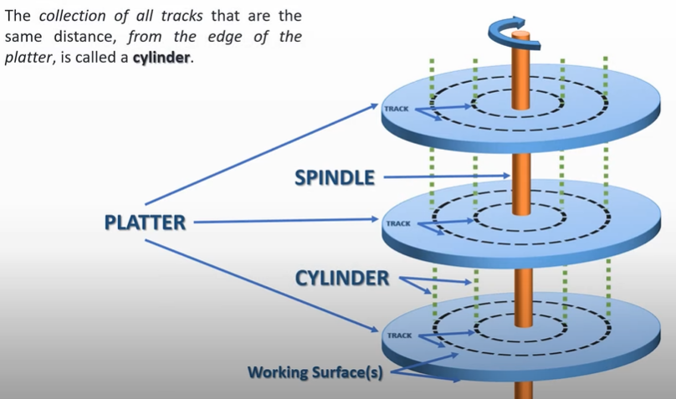
DISK DRIVE COMPONENTS - CYLINDER

Slide 85
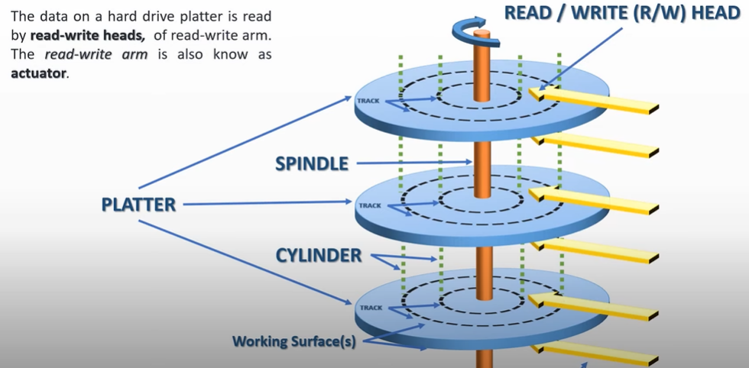
DISK DRIVE COMPONENTS – READ WRITE ARM

Slide 86
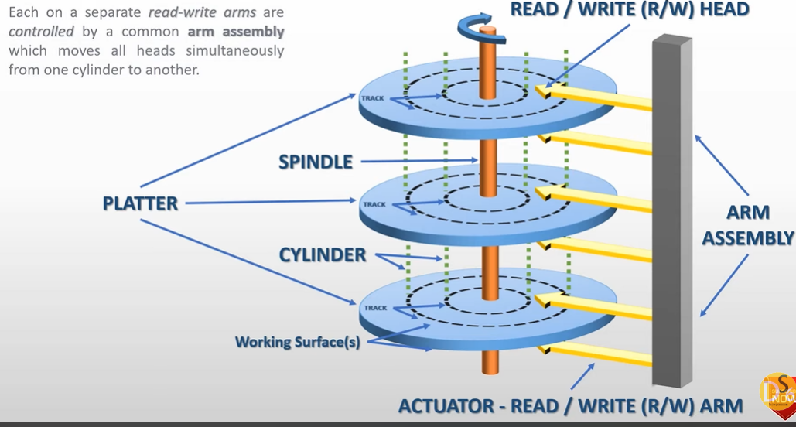


DISK DRIVE COMPONENTS – ARM ASSEMBLY

Slide 87
DISK DRIVE COMPONENTS - PLATTER
A typical HDD consists of one or more flat circular disks called platters
The data is recorded on these platters in binary codes
The set of rotating platters is sealed in a case, called the Head disk Assembly (HAD).
A platter is rigid, round disk coated with magnetic material on both surfaces.
The data is encoded by polarizing the magnetic area, or domains of the disk surface.
Data can be written to or read from both surfaces of the platter.
The number of platters and the storage capacity of each platter determine the total capacity of the drive.

Slide 88
DISK DRIVE COMPONENTS - SPINDLE
A spindle connects all the platters and is connected to a motor.
The motor of the spindle rotates with the constant speed.
The disk platter spins at a speed of several thousands of revolutions per minute.
Common spindle speeds are 5400rpm, 7200rpm, 10000 rpm and 15000 rpm
The speed of the platter is increasing with improvements in technology. Although the extent to which it can be improved is limited.

Slide 89
DISK DRIVE COMPONENTS – READ/WRITE HEAD
Read/write heads , read and write data from or to platters.
Drives have two R/W heads per platter, one for each surface of the platter.
The R/W head changes the magnetic polarization on the surface of the platter when writing data.
While reading data, the head detects the magnetic polarization on the surface of the platter.
During reads and writes, the R/W head senses the magnetic polarization and never touches the surface of the platter.
When the spindle is rotating, there is a microscopic air gap maintained between the R/W heads and platters, known as head flying height.

Slide 90




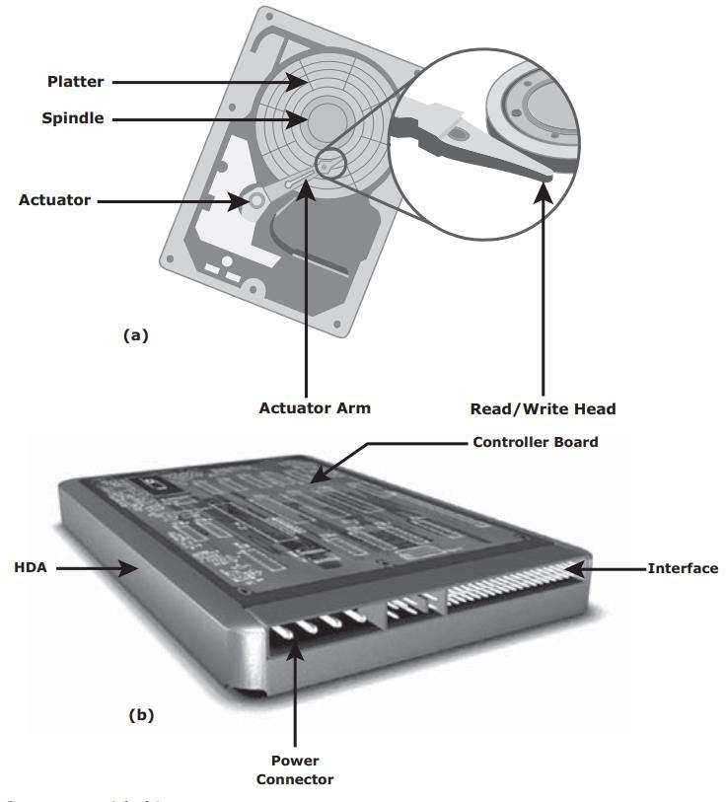
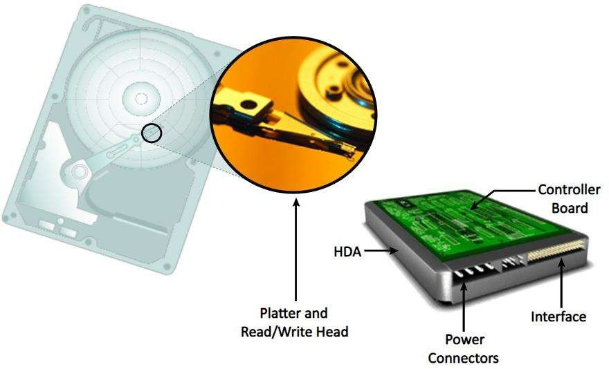



Slide 91










































Slide 92


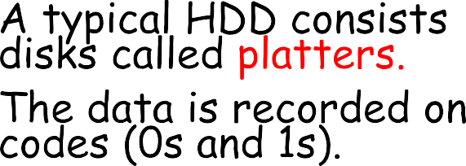

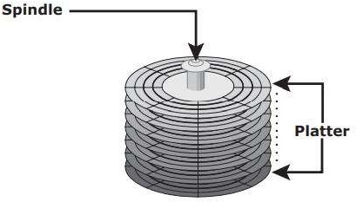


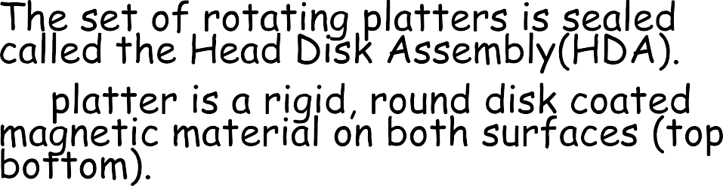

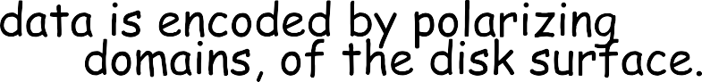

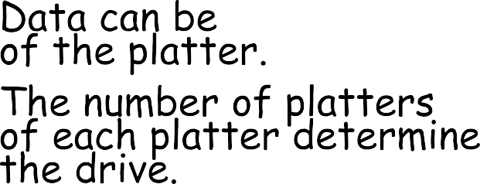






Slide 93





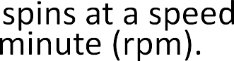





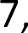

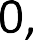





Slide 94











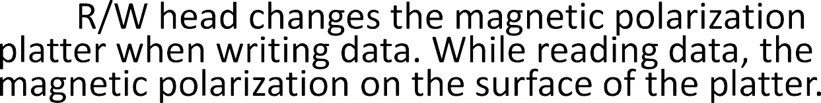





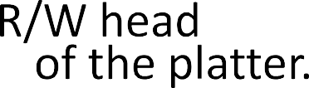






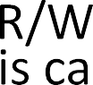











Slide 95


















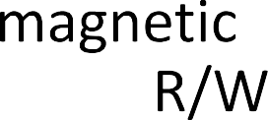











Slide 96








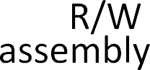






























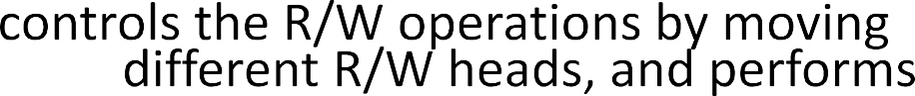

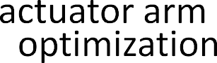

Slide 97
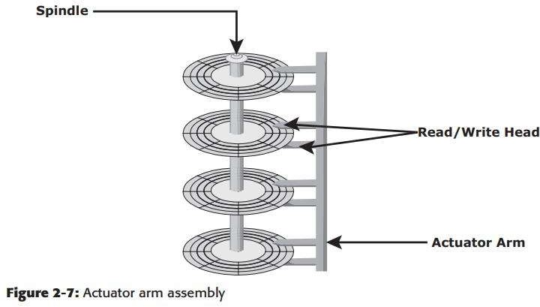

Slide 98
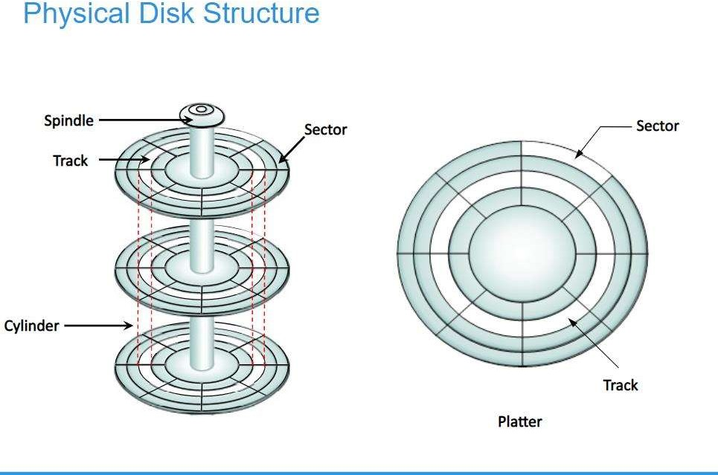

Slide 99







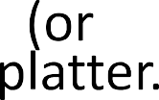

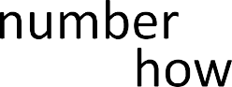





























Slide 100
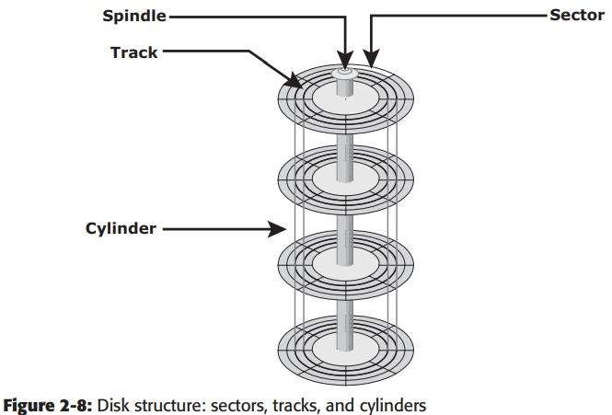

































Slide 101

































Slide 102







































Slide 103


Slide 104
DISK DRIVE PERFORMANCE

Slide 105


Slide 106


Slide 107


Slide 108


Slide 109


Slide 110
HOST ACCESSS TO DATA

Slide 111
HOST ACCESS TO DATA
Data is accessed and stored by applications using the underlying infrastructure.
The key components of this infrastructure are the Operating system Connectivity Storage
The storage device can be internal or external to the host
Host controller card accesses the storage devices using predefined protocols like IDE/ATA, SCSI or Fibre Channel (FC).
FC and iSCSI protocols are used for accessing data from an external storage device

Slide 112
HOST ACCESS TO DATA
External storage devices can be connected to the host directly or through the network.
When the storage is connected directly to the host, it is referred as direct attached storage (DAS)
Data can be accessed over a network in Block level file level Object level

Slide 113
HOST ACCESS TO DATA
In general, Application requests data from the file system by specifying the filename and location.
The file system maps the file attributes to the logical block address of the data and sends the request to the Cylinder-head-sector access and fetches the data
In block level

Slide 114







Slide 115
DIRECT – ATTACHED STORAGE

Slide 116









Slide 117


Slide 118


Slide 119


Slide 120
STORAGE DESIGN BASED ON APPLICATION

Slide 121
STORAGE DESIGN BASED ON APPLICATION REQUIREMENTS AND DISK PERFORMANCE
Determining storage requirements for an application begins with determining the required storage capacity.
This is estimated by: Size of file system used by applications Number of file system used by applications Database components used by applications

Slide 122
STORAGE DESIGN BASED ON APPLICATION REQUIREMENTS AND DISK PERFORMANCE
Factors effecting: Disk Performance I/O Response time Design of storage system are: I/O Size I/O Characteristics Number of I/O generated by the application

Slide 123
STORAGE DESIGN BASED ON APPLICATION REQUIREMENTS AND DISK PERFORMANCE
Disk Service Time (T_{s}) for I/O is the key measure for disk performance.
T_{s} with Disk Utilization rate (U) determines, I/O response time for an application
Total T_{s} = T + L + X T = Sum of seek time L = Rotational Latency X = Internal Transfer Time

Slide 124
EXAMPLE
Average seek time = 5ms => T = 5ms Disk Rotation speed of 15,000rpm / 250rps => Rotational Latency L = (0.5/250rps) Internal Data Transfer Rate = 40MB/s Block size = 32 KB => X = 32 KB/40 MB
Time take by the I/O controller to serve an I/O of block size 32 KB is T_{s} = 5ms + (0.5/250) + 32 KB/40 MB T_{s} = 7.8 ms
Max number of I/Os serviced per second (IOPS) = 1/ T_{s} = 1/(7.8 * 10⁻³) 128 IOPS

Slide 125
MODULE 2
CHAPTER 1: DATA PROTECTION - RAID

Slide 126
RAID IMPLEMENTATION METHODS

Slide 127
RAID IMPLEMENTATION METHODS
Two methods of RAID implementation: Software RAID Hardware RAID
Software Raid:
It uses host-based software to provide RAID functions.
It is implemented at the operating-system level and does not use a dedicated hardware controller to manage the RAID array.
Software RAID implementations offer cost and simplicity benefits when compared with hardware RAID

Slide 128
RAID IMPLEMENTATION METHODS
Software Raid - Limitations:
Performance: Affects overall system performance. This is due to additional CPU cycles required to perform RAID calculations.
Supported Features: Software RAID does not support all RAID levels.
Operating System Compatibility: Software RAID is tied to the host operating system; hence, upgrades to software RAID or to the operating system should be validated for compatibility. This leads to inflexibility in the data processing environment.

Slide 129
RAID IMPLEMENTATION METHODS
Hardware Raid:
In hardware RAID implementations, a specialized hardware controller is implemented either on the host or on the array.
Controller card RAID is a host based hardware RAID implementation in which a specialized RAID controller is installed in the host, and disk drives are connected to it.
Manufacturers also integrate RAID controllers on motherboards.
A host based RAID controller is not an efficient solution in a data center environment with a large number of hosts
The external RAID controller is an array-based hardware RAID.
It acts as an interface between the host and disks

Slide 130
RAID IMPLEMENTATION METHODS
Hardware Raid:
It presents storage volumes to the host and the host manages these volumes as physical drives.
Key functions of RAID controllers: Management and control of disk aggregations Translation of I/O requests between logical disks and physical disks Data regeneration in the event of disk failures.

Slide 131
RAID ARRAY COMPONENTS

Slide 132

RAID ARRAY COMPONENTS
A RAID array is an enclosure that contains a number of disk drives and supporting hardware to implement RAID.
A subset of disks within a RAID array can be grouped to form logical associations called logical arrays, also known as a RAID set or a RAID group.

Slide 133
RAID TECHNIQUES

Slide 134
RAID TECHNIQUES
Striping
Mirroring
Parity
These techniques determine the data availability and performance characteristics of a RAID set

Slide 135
STRIPING
Striping is a technique to spread data across multiple drives to use the drives in parallel
All the read-write heads work simultaneously, allowing more data to be processed in a shorter time and increasing performance, compared to reading and writing from a single disk.
Within each disk in RAID set, a predefined number of contiguously addressable disk blocks are defined as strip.
The set of aligned strips that spans across all the disks within RAID set are called a stripe.
Strip size describes the number of blocks in a strip and is the maximum amount of data that can be written to or read from a single disk in the set, assuming that the accessed data starts at the beginning of the strip.
All the strips in a stripe have a same number of blocks;
Having a smaller strip size means that data is broken into smaller pieces while spread across the disks

Slide 136

STRIPING

Slide 137
STRIPING
Stripe size is a multiple of strip size by the number of data disks in the RAID set.
Stripe width refers to the number of data strips in a stripe.
Striped RAID does not provide any data protection unless parity or mirroring is used.

Slide 138
MIRRORING
Mirroring is a technique whereby the same data is stored on two different disk drives, yielding two copies of the data.
If one disk drive failure occurs, the data is intact on the surviving disk drive and the controller continues to service the host’s data requests from the surviving disk of a mirrored pair.
When the failed disk is replaced with a new disk, the controller copies the data from the surviving disk of the mirrored pair.
This activity is transparent to the host.

Slide 139

MIRRORING

Slide 140
MIRRORING
Advantages:
complete data redundancy,
mirroring enables fast recovery from disk failure.
data protection
Mirroring is not a substitute for data backup. Mirroring constantly captures changes in the data, whereas a backup captures point-in-time images of the data.
Disadvantages:
Mirroring involves duplication of data — the amount of storage capacity needed is twice the amount of data being stored.
Expensive

Slide 141
PARITY
Parity is a method to protect striped data from disk drive failure without the cost of mirroring.
An additional disk drive is added to hold parity, a mathematical construct that allows recreation of the missing data
Parity is a redundancy technique that ensures protection of data without maintaining a full set of duplicate data.
Calculation of parity is a function of the RAID controller.
Parity information can be stored on separate, dedicated disk drives or distributed across all the drives in a RAID set.

Slide 142

PARITY

Slide 143
PARITY
The first four disks, labeled “Data Disks,” contain the data. The fifth disk, labeled “Parity Disk,” stores the parity information, which, in this case, is the sum of the elements in each row.
Now, if one of the data disks fails, the missing value can be calculated by subtracting the sum of the rest of the elements from the parity value.
Here, computation of parity is represented as an arithmetic sum of the data. However, parity calculation is a bitwise XOR operation.
XOR Operation:
A bit-by-bit Exclusive -OR (XOR) operation takes two bit patterns of equal length and performs the logical XOR operation on each pair of corresponding bits.
The result in each position is 1 if the two bits are different, and 0 if they are the same.
The truth table of the XOR operation is shown next (A and B denote inputs and C, the output the XOR operation).

Slide 144

PARITY
If any of the data from A, B or C is lost, it can be reproduced by performing an XOR operation on the remaining available data.
Eg: If a disk containing all the data from A fails, the data can be regenerated by performing an XOR between B & C

Slide 145
PARITY
Advantages:
Compared to mirroring, parity implementation considerably reduces the cost associated with data protection.
Disadvantages:
Parity information is generated from data on the data disk. Therefore, parity is recalculated every time there is a change in data.
This recalculation is time-consuming and affects the performance of the RAID array.
For parity RAID, the stripe size calculation does not include the parity strip.
Eg: in a five (4 + 1) disk parity RAID set with a strip size of 64 KB, the stripe size will be 256 KB (64 KB x 4)

Slide 146
RAID LEVELS

Slide 147
RAID LEVELS
RAID Level selection is determined by below factors:
Application performance
data availability requirements
cost
RAID Levels are defined on the basis of:
Striping
Mirroring
Parity techniques
Some RAID levels use a single technique whereas others use a combination of techniques

Slide 148

RAID LEVELS

Slide 149
RAID 0
RAID 0 configuration uses data striping techniques, where data is striped across all the disks within a RAID set. Therefore it utilizes the full storage capacity of a RAID set.
To read data, all the strips are put back together by the controller.
Fig shows RAID 0 in an array in which data is striped across five disks.
When the number of drives in the RAID set increases, performance improves because more data can be read or written simultaneously.
RAID 0 is a good option for applications that need high I/O throughput.
However, if these applications require high availability during drive failures, RAID 0 does not provide data protection and availability

Slide 150

RAID 0

Slide 151
RAID 1
RAID 1 is based on the mirroring technique.
In this RAID configuration, data is mirrored to provide fault tolerance
RAID 1 set consists of two disk drives and every write is written to both disks.
The mirroring is transparent to the host.
During disk failure, the impact on data recovery in RAID 1 is the least among all RAID implementations. This is because the RAID controller uses the mirror drive for data recovery.
RAID 1 is suitable for applications that require high availability and cost is no constraint.

Slide 152

RAID 1

Slide 153
NESTED RAID
Most data centers require data redundancy and performance from their RAID arrays.
RAID 1+0 and RAID 0+1 combine the performance benefits of RAID 0 with the redundancy benefits of RAID 1.
They use striping and mirroring techniques and combine their benefits.
These types of RAID require an even number of disks, the minimum being four

Slide 154

NESTED RAID

Slide 155
NESTED RAID - RAID 1 + 0
RAID 1+0 is also known as RAID 10 (Ten) or RAID 1/0.
RAID 1+0 performs well for workloads with small, random, write-intensive I/Os.
Some applications that benefit from RAID 1+0 include the following:
High transaction rate Online Transaction Processing (OLTP) Large messaging installations
Database applications with write intensive random access workloads
RAID 1+0 is also called striped mirror.
The basic element of RAID 1+0 is a mirrored pair, which means that data is first mirrored and then both copies of the data are striped across multiple disk drive pairs in a RAID set.
When replacing a failed drive, only the mirror is rebuilt. The disk array controller uses the surviving drive in the mirrored pair for data recovery and continuous operation.

Slide 156
NESTED RAID - WORKING OF RAID 1 + 0
Eg: consider an example of six disks forming a RAID 1+0 (RAID 1 first and then RAID 0) set.
These six disks are paired into three sets of two disks, where each set acts as a RAID 1 set (mirrored pair of disks). Data is then striped across all the three mirrored sets to form RAID 0.
Following are the steps performed in RAID 1+0
Drives 1+2 = RAID 1 (Mirror Set A)
Drives 3+4 = RAID 1 (Mirror Set B)
Drives 5+6 = RAID 1 (Mirror Set C)
Now, RAID 0 striping is performed across sets A through C.
In this configuration, if drive 5 fails, then the mirror set C alone is affected. It still has drive 6 and continues to function and the entire RAID 1+0 array also keeps functioning.
Now, suppose drive 3 fails while drive 5 was being replaced. In this case the array still continues to function because drive 3 is in a different mirror set.
So, in this configuration, up to three drives can fail without affecting the array, as long as they are all in different mirror sets.

Slide 157
NESTED RAID - RAID 0 + 1
RAID 0 + 1 is also called a mirrored stripe.
The basic element of RAID 0 + 1 is a stripe.
This means that the process of striping data across disk drives is performed initially and then the entire stripe is mirrored.
In this configuration, if one drive fails, then the entire stripe is faulted.

Slide 158
NESTED RAID - WORKING OF RAID 0 + 1
Eg: Consider the same example of six disks forming a RAID 0+1 (that is, RAID 0 first and then RAID 1).
Here, six disks are paired into two sets of three disks each.
Each of these sets, in turn, act as a RAID 0 set that contains three disks and then these two sets are mirrored to form RAID 1.
Following are the steps performed in RAID 0+1
Drives 1 + 2 + 3 = RAID 0 (Stripe Set A)
Drives 4 + 5 + 6 = RAID 0 (Stripe Set B)
These two stripe sets are mirrored.
If one of the drives, say drive 3, fails, the entire stripe set A fails.
A rebuild operation copies the entire stripe, copying the data from each disk in the healthy stripe to an equivalent disk in the failed stripe.
This causes increased and unnecessary I/O load on the surviving disks and makes the RAID set more vulnerable to a second disk failure.

Slide 159
RAID 3
RAID 3 stripes data for high performance and uses parity for improved fault tolerance.
Parity information is stored on a dedicated drive so that data can be reconstructed if a drive fails. For example, of five disks, four are used for data and one is used for parity.
RAID 3 always reads and writes complete stripes of data across all disks, as the drives operate in parallel. There are no partial writes that update one out of many strips in a stripe.
RAID 3 provides good bandwidth for the transfer of large volumes of data. RAID 3 is used in applications that involve large sequential data access, such as video streaming.

Slide 160

RAID 3

Slide 161
RAID 4
RAID 4 stripes data for high performance and uses parity for improved fault tolerance. Data is striped across all disks except the parity disk in the array.
Parity information is stored on a dedicated disk so that the data can be rebuilt if a drive fails. Striping is done at the block level.
Unlike RAID 3, data disks in RAID 4 can be accessed independently so that specific data elements can be read or written on single disk without read or write of an entire stripe.
RAID 4 provides good read throughput and reasonable write throughput.

Slide 162
RAID 5
RAID 5 is a versatile RAID implementation.
It is similar to RAID 4 because it uses striping. The drives (strips) are also independently accessible.
The difference between RAID 4 and RAID 5 is the parity location. In RAID 4, parity is written to a dedicated drive, creating a write bottleneck for the parity disk
In RAID 5, parity is distributed across all disks. The distribution of parity in RAID 5 overcomes the Write bottleneck. Below Figure illustrates the RAID implementation.
RAID 5 is good for random, read-intensive I/O applications and preferred for messaging, data mining, medium-performance media serving, and relational database management system
(RDBMS) implementations, in which database administrators (DBAs) optimize data access.

Slide 163

RAID 5

Slide 164
RAID 6
RAID 6 includes a second parity element to enable survival in the event of the failure of two disks in a RAID group. Therefore, a RAID 6 implementation requires at least four disks.
RAID 6 distributes the parity across all the disks. The write penalty in RAID 6 is more than that in RAID 5; therefore, RAID 5 writes perform better than RAID 6.
The rebuild operation in RAID 6 may take longer than that in RAID 5 due to the presence of two parity sets.

Slide 165

RAID 6

Slide 166
RAID IMPACT ON DISK PERFORMANCE

Slide 167
RAID IMPACT ON DISK PERFORMANCE
When choosing a RAID type, it is imperative to consider its impact on disk performance and application IOPS.
In both mirrored (RAID 1) and parity RAID (RAID 5) configurations, every write operation translates into more I/O overhead for the disks which is referred to as write penalty.
In a RAID 1 implementation, every write operation must be performed on two disks configured as a mirrored pair. The write penalty is 2.
In a RAID 5 implementation, a write operation may manifest as four I/O operations. When performing small I/Os to a disk configured with RAID 5, the controller has to read, calculate, and write a parity segment for every data write operation.
Fig illustrates a single write operation on RAID 5 that contains a group of five disks

Slide 168

RAID IMPACT ON DISK PERFORMANCE

Slide 169
RAID IMPACT ON DISK PERFORMANCE
Four of these disks are used for data and one is used for parity.
The parity (Ep) at the controller is calculated as follows:
Ep = E1 + E2 + E3 + E4 (XOR operations)
Whenever the controller performs a write I/O, parity must be computed by reading the old parity (Ep old) and the old data (E4 old) from the disk, which means two read I/Os.
The new parity (Ep new) is computed as follows:
Ep new = Ep old – E4 old + E4 new (XOR operations)
After computing the new parity, the controller completes the write I/O by doing two write
I/Os for the new data and the new parity onto the disks..
Therefore, the controller performs two disk reads and two disk writes for every write operation, and the write penalty is 4.
In RAID 6, which maintains dual parity, a disk write requires three read operations: two parity and one data.
After calculating both new parities, the controller performs three write operations: two parity and an I/O.
Therefore, in a RAID 6 implementation, the controller performs six I/O operations for each write I/O, and the write penalty is 6.

Slide 170
MODULE 2
CHAPTER 2: INTELLIGENT STORAGE SYSTEM

Slide 171
INTRODUCTION

Slide 172
INTRODUCTION
Business-critical applications require high levels of performance availability, security, and scalability.
RAID technology made an important contribution to enhancing storage performance and reliability.
With a RAID implementation, could not meet the performance requirements of today’s applications
With advancements in technology, a new breed of storage solutions, known as intelligent storage systems.
Highly optimized I/O processing capabilities
Meet the requirements of performance-sensitive applications
Management, allocation and utilization of storage resources.
Virtual storage provisioning and automated storage tiering, has added a new dimension to storage system performance, scalability and availability.

Slide 173
COMPONENTS OF AN INTELLIGENT STORAGE SYSTEM

Slide 174

COMPONNETS OF AN INTELLIGENT STORAGE SYSTEM (ISS)
Front end, Cache, Back end, Physical disks

Slide 175
FRONT END
Front end provides the interface between the storage system abs the host.
It consists of two components: front end ports and front end controllers.
A front end has redundant controllers for high availability and each controller contains multiple ports that enable large numbers of hosts to connect to the intelligent storage system.
Each front end controller has processing logic that executes the appropriate transport protocol, such as fibre channel, iSCSI for storage connection.
Front end controllers route data to and from cache via the internal data bus.
When the cache receives the write data, the controller sends an acknowledgement message back to the host.

Slide 176

Cache
Cache is semiconductor memory where data is placed temporarily to reduce the time required to service I/O requests from the host.
Accessing data from the cache is fast and typically takes less than a millisecond

Slide 177

READ OPERATION WITH CACHE
Prefetch or Read-ahead algorithm is used when read are sequential
ISS offers fixed and variable Prefetch

Slide 178
WRITE OPERATION WITH CACHE
Write operations with cache provide performance advantages over writing directly to disks.
When an I/O is written to cache and acknowledged, it is completed in far less time( from the host’s perspective) than it would take to write directly to disk.
A write operation with cache is completed in the following ways:
Write-back cache: Data is placed in cache and an acknowledgment is sent to the host immediately. Later, data from several writes are committed (de-staged) to the disk. Write response times are much faster because the write operations are isolated from the mechanical delays of the disk. However, uncommitted data is at risk of loss if cache failures occur.
Write-through cache: Data is placed in the cache and immediately written to disk, and an acknowledgment is sent to the host. Because data is committed to disk as it arrives, the risks of data loss are low, but the write-response time is longer of the disk operations.

Slide 179
Cache Management
Various cache management algorithms are implemented in intelligent storage systems.
The most commonly used algorithms are:
Least Recently Used (LRU):
An algorithm that continuously monitors data access in cache and identifies the cache pages that have not been accessed for a long time.
LRU either frees up these pages or marks them for reuse.
This algorithm is based on the assumption that data that has not been accessed for a while will not be requested by the host
Most Recently Used (MRU):
This algorithm is the opposite of LRU, where the pages that have been accessed most recently are freed up or marked for reuse.
This algorithm is based on the assumption that recently accessed data may not be required for a while.

Slide 180

Cache Flushing
Storage system take action to flush dirty pages.
Flushing is process that commits data from cache to the disk.
Idle flushing
High watermark flushing
Forced flushing

Slide 181
Cache Data Protection
Protecting cache data against failure: (Power failure)
Cache mirroring
Each write to the cache is held in two different memory locations on two independent memory cards
Cache coherency(only writes are mirrored)
Cache vaulting
Cache is exposed to the risk of uncommitted data loss due to power failure.
In the event of power failure, uncommitted data is dumped to a dedicated set of drives called vault drives

Slide 182

Back end

Slide 183
Back end
The back end provides an interface between cache and the physical disks.
It consists of two components: back-end ports and back-end controllers.
The back-end controls data transfers between cache and physical disks.
From Cache, data is sent to the back end and then routed to the destination disk.
Physical disks are connected to ports on the back end.
The back-end controller communicates with the disks when performing reads and writes and also provide additional, but limited, temporary data storage.
The algorithms implemented on back-end controllers provide error detection and correction, along with RAID functionality.
For high data protection and high availability, storage systems are configured with dual controllers with multiple ports. Such configurations provide an alternative path to physical disks if a controller or port failure occurs.
This reliability is further enhanced if the disks are also dual-ported. In that case, each disk port can connect to a separate controller. Multiple controllers also facilitate load balancing.

Slide 184

Physical disk

Slide 185
Physical disk
Physical disks are connected to the back-end storage controller and provide persistent data storage.
Modern intelligent storage systems provide support to a variety of disk drives with different speeds and types, such as FC, SATA, SAS, and flash drives.
They also support the use of mix of flash, FC, or SATA within the same array.

Slide 186
TYPES OF INTELLIGENT STORAGE SYSTEM

Slide 187
Types
Intelligent storage systems fall into one of the following two categories:
High end Storage system
Midrange storage system
High-end storage systems have been implemented with active-active configuration, whereas midrange storage systems have been implemented with active-passive configuration.

Slide 188

HIGH END STORAGE SYSTEMS

Slide 189
HIGH END STORAGE SYSTEMS
High-end storage systems, referred to as active-active arrays, are generally aimed at large enterprise applications.
These systems are designed with a large number of controllers and cache memory
An active-active array implies that the host can perform I/Os to its LUNs (Device which supports read write operation) through any of the available controllers

Slide 190

MID RANGE STORAGE SYSTEMS

Slide 191
MIDRANGE STORAGE SYSTEMS
Midrange storage systems are also referred to as active-passive arrays and are best suited for small- and medium-sized enterprise applications.
They also provide optimal storage solutions at a lower cost.
In an active-passive array, a host can perform I/O to a LUN only through the controller that owns the LUN.
Midrange storage systems are typically designed with two controllers, each of which contains host interfaces, cache, RAID controllers, and interface to disk drives

Slide 192
MODULE 2
CHAPTER 3: FIBRE CHANNEL STORAGE AREA NETWORKS – FIBRE CHANNEL

Slide 193
INTRODUCTION

Slide 194
Introduction
Organizations are experiencing an explosive growth in information.
Information needs to be
Stored
Protected
Optimized
and managed efficiently
Data center managers are burdened with the challenging task of providing low-cost, high-performance information management solutions.
An effective information management solution provide the following:
Just-in-time information to business users
Integration of information infrastructure with business processes
Flexible and resilient storage infrastructure

Slide 195
Introduction
Direct-attached storage (DAS) is often referred to as a stovepiped storage environment.
Hosts “own” the storage, and it is difficult to manage and share resources on these isolated storage devices
Efforts to organize this dispersed data led to the emergence of the storage area network (SAN)
SAN: It is a high-speed, dedicated network of servers and shared storage devices.
Centralizes storage and management
Enables sharing of storage resources across multiple servers
Meets increasing storage demands efficiently with better economies of scale
Common SAN deployments are:
Fibre Channel(FC) SAN: uses FC protocol for communication
IP SAN: uses IP-based protocols for communication

Slide 196
FIBRE CHANNEL: OVERVIEW

Slide 197
Fibre Channel
Fibre Channel is a high-speed network technology that runs on high-speed optical fiber cables and serial copper cables.
Meet the demand for increased speeds of data transfer between servers and mass storage systems.
High data transmission speed is an important feature of the FC networking technology
The FC architecture is highly scalable.

Slide 198
THE SAN AND ITS EVOLUTION

Slide 199
THE SAN AND ITS EVOLUTION
SAN caries data between servers (or hosts) and storage devices through Fibre Channel network.
Enables storage consolidation (merge)
Storage management becomes centralized and less complex, which further reduces the cost of managing information
Enables organizations to connect geographically dispersed servers and storage.
Enables storage to be shared across multiple servers.
Improves the utilization of storage resources compared to direct-attached storage architecture
Reduces the total amount of storage an organization needs to purchase and manage.

Slide 200

THE SAN AND ITS EVOLUTION
FC hub as a connectivity device.
This configuration of an FC SAN is known as a Fibre Channel Arbitrated Loop
Limitations with hub gave way to performance FC switches

Slide 201
COMPONENTS OF FC SAN

Slide 202
COMPONENTS OF FC SAN
Node (server and storage) ports
Cables and connectors
Interconnecting devices such as FC switches and hubs
SAN management software

Slide 203

NODE PORTS
In FC network, the end devices, such as hosts, storage arrays, and tape libraries, are all referred to as nodes.
Each node requires one or more ports to provide a physical interface for communicating with other nodes.
Exist on
Host bus adaptor (HBA) in server
Front-end adaptors in storage
Each port has a transmit (Tx) link and a receive (Rx) link

Slide 204

CABLES AND CONNECTORS
SAN implementation uses
Copper cables for short distance (back-end)
Optical fiber cables for long distance
Two types of optical cables: single mode and multimode
Single-mode Fiber ( SMF) | Multimode fiber (MMF)
Carries single beam of light | Can carry multiple beams of light simultaneously
Distance up to 10km | Used for short distance (Modal dispersion≈ collision – weakens signal strength after certain distance

Slide 205

Attached at the end of cable
Enable swift (rapid) connection and disconnection of the cable to and from a port
Commonly used connectors for fiber optic cables are:
Standard Connector (SC)
- Duplex connectors
Lucent Connector (LC)
- Duplex connectors
Straight Tip (ST)
- Patch panel connectors
- Simplex connectors

Slide 206
INTERCONNECT DEVICES
HUBS | SWITCHES | DIRECTORS
Physically connect nodes in a logical loop or a physical star topology Provide limited connectivity and scalability All nodes must share the loop because data travels through all the connection points Because of the availability of low-cost and high-performance switches, hubs are no longer used in FC SANs | More intelligent than hubs and directly route data from one physical port to another Switches are available with fixed port count or modular design. Modes do not share the bandwidth Instead, each node has a dedicated communication path. | High-end switches with a higher port count and better fault tolerance capabilities. Always modular, and its port count can be increases by inserting additional ‘line cards’ or ‘blades’. High end switches and directors contain redundant components.

Slide 207
SAN MANAGEMENT SOFTWARE
A suite of tools used in a SAN to manage interfaces between host and storage arrays.
Provides integrated management of SAN environment
Enables web based management using GUI or CLI.
Key management functions:
Mapping of storage devices, switches and servers.
Monitoring and generating alerts for discovered devices.
Logical partitioning of SAN (Zoning)
Management of SAN components (HBAs, Storage components and interconnecting devices)

